Slide 1
SESSION: 4
K-MAP
Arithmetic Circuits
Combinational Circuits and Sequential Circuits

Slide 2
K-MAP
The K-map consists of Squares, where each square represents one minterm of the function. The squares corresponding to minterms that produce a TRUE value for the function are marked by a 1, others can be left empty, or can be marked by a 0. The maps for functions of two, three and four variables are shown in the following figure.

Slide 3
K-MAP
THE KARNAUGH MAP METHOD PROVIDES A SIMPLEST AND SYSTEMATIC METHOD FOR SIMPLIFYING ON MINIMIZING A GIVEN BOOLEAN EXPRESSION.
TWO VARIABLE MAP:-
B
A
0 A’B’ | 1 A’B
2 AB’ | 3 A’B’

Slide 4
THREE VARIABLE MAP
0 A’B’C’ | 1 A’B’C
2 A’BC’ | 3 A’BC
6 ABC’ | 7 ABC
4 AB’C’ | 5 AB’C
B’
A’
B
A
B’
C’
C

Slide 5
FOUR VARIABLE MAP
CD
AB
0 | 1 | 3 | 2
4 | 5 | 7 | 6
12 | 13 | 15 | 14
8 | 9 | 11 | 10

Slide 6
QUESTION for practice
F (A, B, C, D) = Σ (0, 1, 2,4 5,6 8, 9, 10).

Slide 7
HALF ADDER
(TWO INPUTS & TWO OUTPUTS)
It will take two inputs and it will give two outputs one is SUM and another is CARRY
If two inputs P & Q than for sum
S =P’Q+PQ’=P⊕Q
And Carry
C=X.Y

Slide 8
FULL ADDER
It will take one additional input carry input and it will give two outputs SUM and CARRY.If inputs are P,Q,CI than outputs will be S and CO.
S=(P⊕Q)⊕CI
And Carry output
CO=PQ+(P⊕Q).CI

Slide 9
FLIP-FLOPS
A flip-flop is a binary cell capable of storing one bit of information.It has two outputs one for the normal value and one for the complement value of bit stored in it.
Characteristics of flip-flop

Slide 10
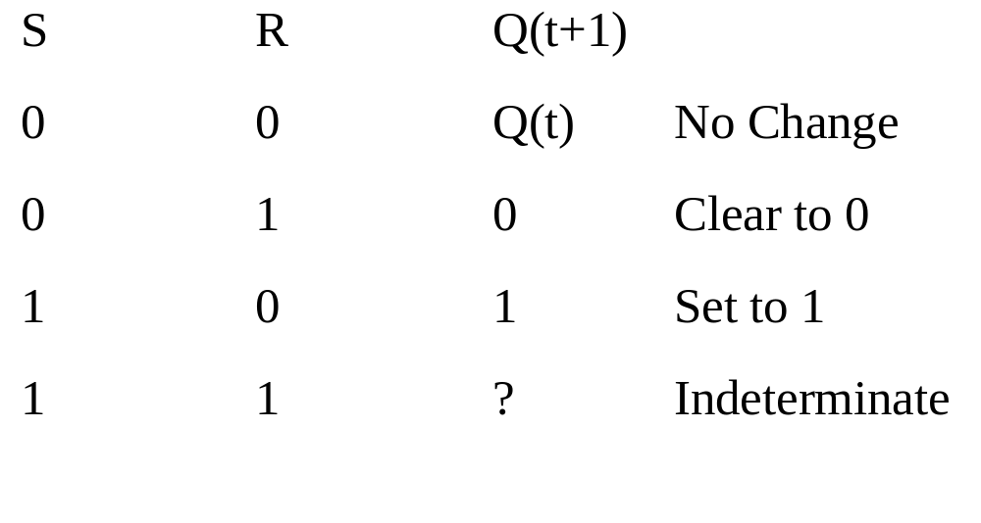
SR FLIP-FLOP

Slide 11
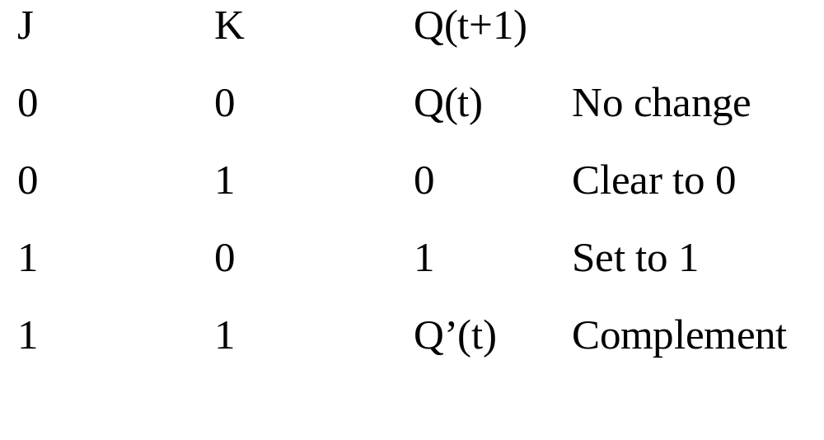
J-K FLIP-FLOP

Slide 12
MASTER SLAVE FLIP-FLOP
This type of circuit is consist of two flip-flop.The first is the master, which respond to the positive level of the clock and the second is the slave , which respond to the negative level of the clock.The result is that the output changes during 1-to-0 transition of the clock signal. The trend is away from the use of master-slave flip-flops and towards edge-triggered flip-flops.

Slide 13
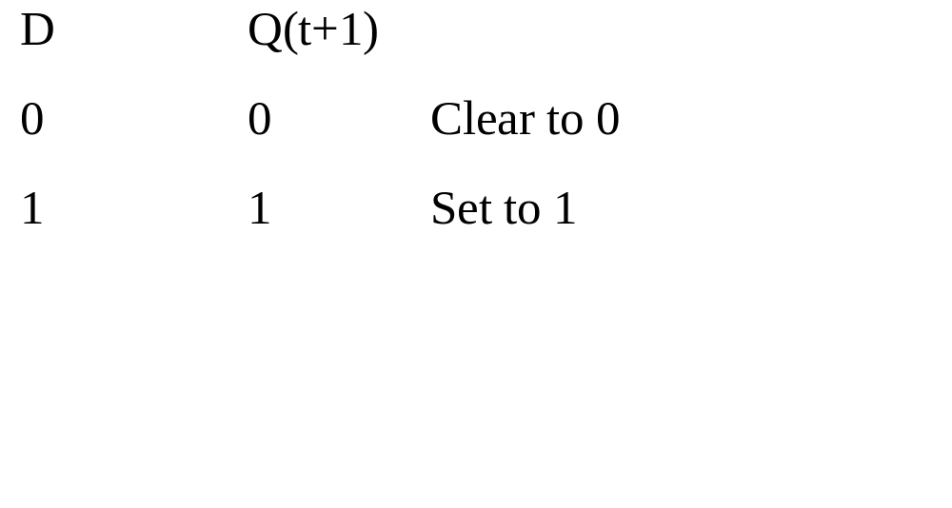
D FLIP-FLOP

Slide 14
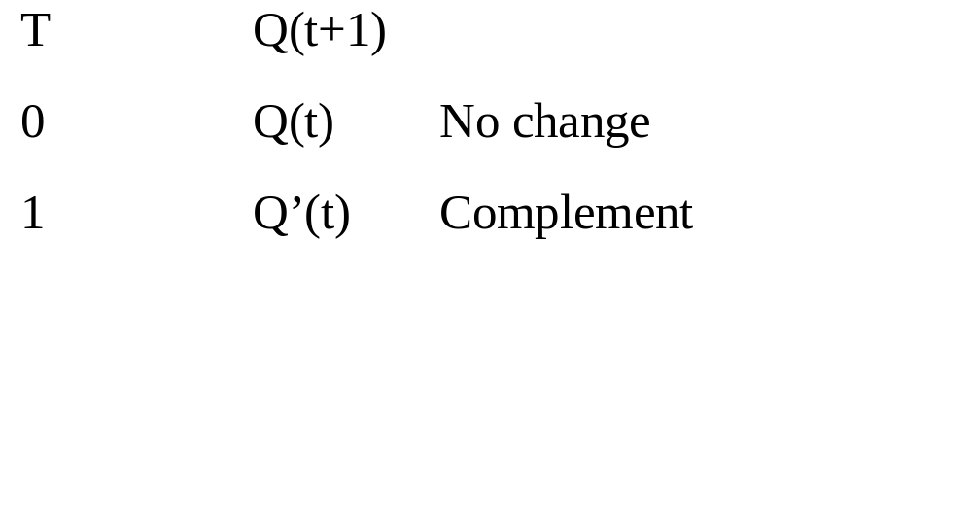
T FLIP-FLOP

Slide 15
DECODER
A decoder is a combinational circuit that converts binary information from the n coded inputs to a maximum of 2^{n} unique outputs. If the n-bit coded information has unused bit combinations, the decoder may have less than 2^{n} outputs.

Slide 16
ENCODER
An encoder is a digital circuit that performs the inverse of a decoder.An encoder has 2^{n} (or less) input lines and n output lines.The output lines generate the binary code corresponding to the input value.

Slide 17
MULTIPLEXERS
A multiplexer is a combinational circuit that recieves binary information from one of 2^{n} input data lines and directs it to a single output line .The selection of a particular input data line for the output is determined by a set of selection inputs.

